Slide 1
LINKED LISTS

Slide 2
CONCATENATION OF TWO LINKED LISTS
We take two lists and then append the second list to the end of the first list.
To append the second list to the end of the
first list, we need to change the link pointer
in the last node of the first list to point to the
first node of the second list.

Slide 3
Algorithm appendTwoLists
{
Print (“ Enter the first file name)
Read (filename)
Open (filename)
build(pList1,filename)
printList(pList1)
Print (“ Enter the second file name)
Read (filename)
Open (filename)
build(pList2,filename)
printList(pList2)
append(pList1, pList2)
printList(pList1)
Return
}

Slide 4
Algorithm build( LIST * pList, val file <data file>)
{
pList = createList
loop (not end of file)
{
read(file into dataIn)
searchList(pList, pPre, pLoc, dataIn.key)
addNode(pList, pPre, dataIn)
}
Algorithm append (LIST * pList1, LIST * pList2 )
{
If (pList1 → count = = 0)
{
pList1 → head = pList2 → head
else

Slide 5
2) pLoc = pList1 → head
3) loop(pLoc → link not null)
{
pLoc = pLoc → link
pList1 → count = pList1 + pList2 → count
return
}

Slide 6
Reversing a Linked list
Algorithm Node * ReverseList( Node ** List )
{
Node *temp1 = *List;
Node * temp2 = NULL;
Node * temp3 = NULL;
while ( temp1 )
{
// set the head to last node
*List = temp1;
// save the next ptr in temp2
temp2= temp1->pNext;
// change next to previous
temp1->pNext = temp3;
temp3 = temp1;
temp1 = temp2;
}
return *List;
}

Slide 7
Sorting Linked list in Descending Order
struct node
{
int value;
node* NEXT;
}
Assume HEAD pointer denotes the first element in the
linked list only change the values…don’t have to
change the pointers.
1) Algorithm Sort( Node *Head)
{
node* first, second, temp;
first= Head;
}

Slide 8
2) while(first!=null)
{
second=first->NEXT;
while(second!=null)
{
if(first->value < second->value)
{
temp = new node();
temp->value=first->value;
first->value=second->value;
second->value=temp->value;
delete temp;
}
second=second->NEXT;
}
first=first->NEXT;
}
}

Slide 9
Insert a node into a sorted linked list
void sortedInsert(Node * head, Node* newNode)
{
1) Node *current = head;
2) Traverse the list until you find item bigger the
new node value.
while (current!= NULL && current->data <
newNode->data)
{
current = current->next;
}
3) Insert the new node before the big item
newNode->next = current->next;
current = newNode;
}

Slide 10
Polynomial Representation
Polynomial consists of two components, a
coefficient and an exponent and ‘x’ is a
formal parameter.
The polynomial is the sum of terms, each
of which consists of coefficient and an
Exponent for the formal parameter.
In computer we implement the polynomial as the list of structures consisting of coefficients and exponents using single linked lists.

Slide 11
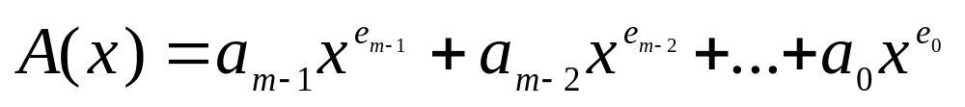
Polynomial Representation
coef expon link

Slide 12
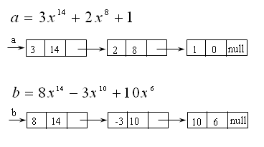
Example

Slide 13
Algorithm for creating and representing a polynomial using single linked list
Algorithm createpoly(LIST *pList)
{
Define a structure LIST with fields DATA, sign,
coefficient, exponentiation and link
tydef struct node
{
Int coef;
Int expo;
void * dataptr
struct node *link
} NODE;

Slide 14
typedef struct
{
int count;
NODE * head;
NODE * rear;
} LIST;
2) LIST *plist;
Allocate (plist)
plist = (LIST *) malloc(sizeof(LIST))));
if (plist)
{
plist → head = null;
plist → rear = null;
plist →count = 0
}
return(plist);
}

Slide 15
3)If (pNew → link == null)
{
return false;
Else
pNew = (LIST *) malloc(sizeof(LIST));
pNew →dataptr = dataInptr;
pNew → coef = c;
pNew → expo = e;
pNew → link = null;
}

Slide 16
4) Displaying the nodes in the list
If (pNew → link != NULL)
{
dataoutptr = pLoc → link;
dataoutcoef = pLoc → coef;
dataoutexpo = pLoc → expo;
}

Slide 17
POLYNOMIAL ADDITION
Input two polynomial expressions and
compare the powers of both the
expressions.
If the powers are equal then add the coefficients of the formal parameter x.

Slide 18
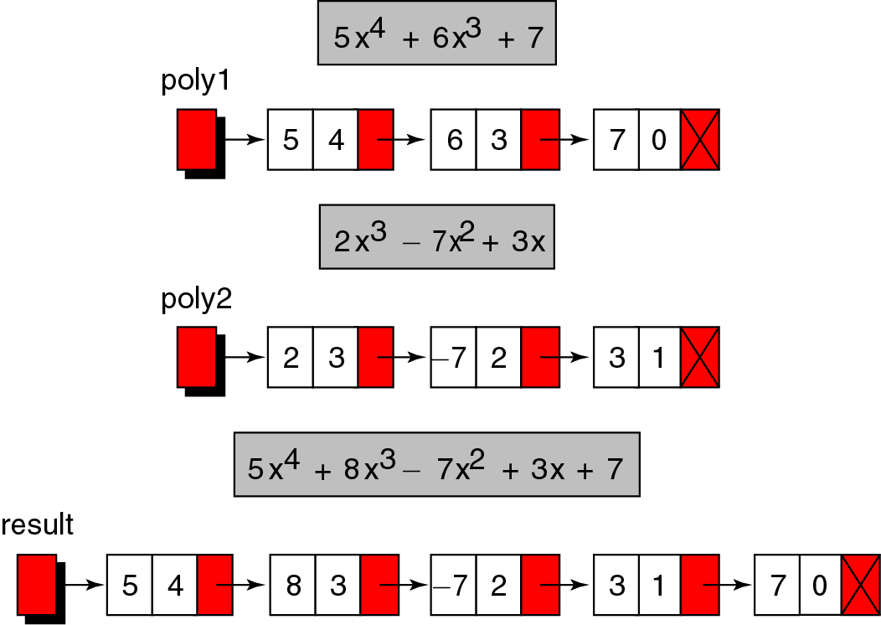
POLYNOMIAL ADDITION

Slide 19
Algorithm for polynomial addition
Algorithm polyadd(pnode *p, pnode *q)
1) pnode *r = NULL;e=exponent; c=coefficient;
2) while((p!=NULL) && (q != NULL))
{
3) if(p->exp > q->exp)
{
r = insert(r,p->exp,p->coeff);
p = p->link;
}
else
4) if(p->exp < q->exp)
{
r = insert(r,q->exp,q->coeff)

Slide 20
q = q->link;
}
else
{
c = p->coeff + q->coeff;
e = q->exp;
r = insert( r, e,c);
p = p->link;
q = q->link;
}

Slide 21
while(p != NULL)
{
r = insert( r, p->exp,p->coeff);
p = p->link;
}
while(q!=NULL)
{
r = insert( r, q->exp,q->coeff);
q = q->link;
}
return(r);
}

